Slide 1
Kubernetes Cluster Failure Prediction Model
Using Random Forest for Proactive Failure Detection

Slide 2
Introduction
Imagine a Kubernetes cluster running seamlessly—until an unexpected failure disrupts operations, causing downtime and performance degradation. What if we could predict these failures before they happen? This project introduces a machine learning-powered failure prediction model that analyzes historical Kubernetes metrics to detect early signs of system instability. By leveraging a Random Forest algorithm, our approach identifies patterns in CPU usage, memory consumption, pod restarts, and network activity, enabling proactive monitoring and automated failure prevention. This not only enhances system reliability but also optimizes resource management, ensuring a smarter, self-healing Kubernetes environment.

Slide 3
Failure Prediction Approach
The model predicts Kubernetes pod failures (1) or stability (0) based on system metrics.
Key Steps:
Data Preprocessing: Load CSV, process timestamps, normalize features.
Feature Engineering: Select critical Kubernetes metrics impacting failures.
Model Selection: Random Forest for high accuracy & interpretability.
Training & Evaluation: 80/20 Train-Test split, balanced training, performance metrics.

Slide 4
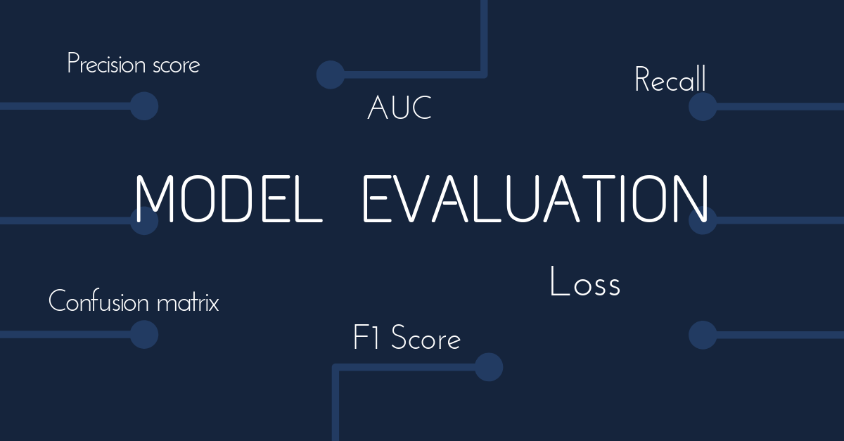
Key Metrics Used
Accuracy: Measures overall correct predictions.
ROC-AUC Score: Assesses the model’s ability to differentiate failures from normal states.
Classification Report: Provides Precision, Recall, and F1-score for performance evaluation.

Slide 5
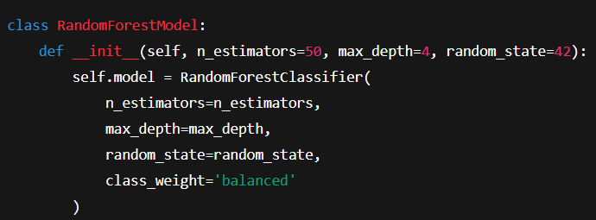
Model Implementation
Model Selection: We use a RandomForestClassifier with optimized parameters to balance performance and prevent overfitting.
Key Implementation:

Slide 6
Model Training & Results
Model Performance Summary 📊
📌 Overall Metrics: ✔ Accuracy: ~85% ✔ ROC-AUC Score: ~0.85
📌 Classification Report: 🔹 Class 0 (Normal) ✔ Precision: 0.87 ✔ Recall: 0.89 ✔ F1-score: 0.88
🔹 Class 1 (Failure) ✔ Precision: 0.82 ✔ Recall: 0.79 ✔ F1-score: 0.80

Slide 7

Model Deployment & Future Enhancements
Deployment Steps 🚀
Save the Model:
Load the Model:
Future Enhancements
✅ Real-time monitoring integration for proactive failure detection. ✅ Optimized feature selection to enhance prediction accuracy. ✅ Scalability improvements to support large Kubernetes clusters efficiently.

